Slide 1




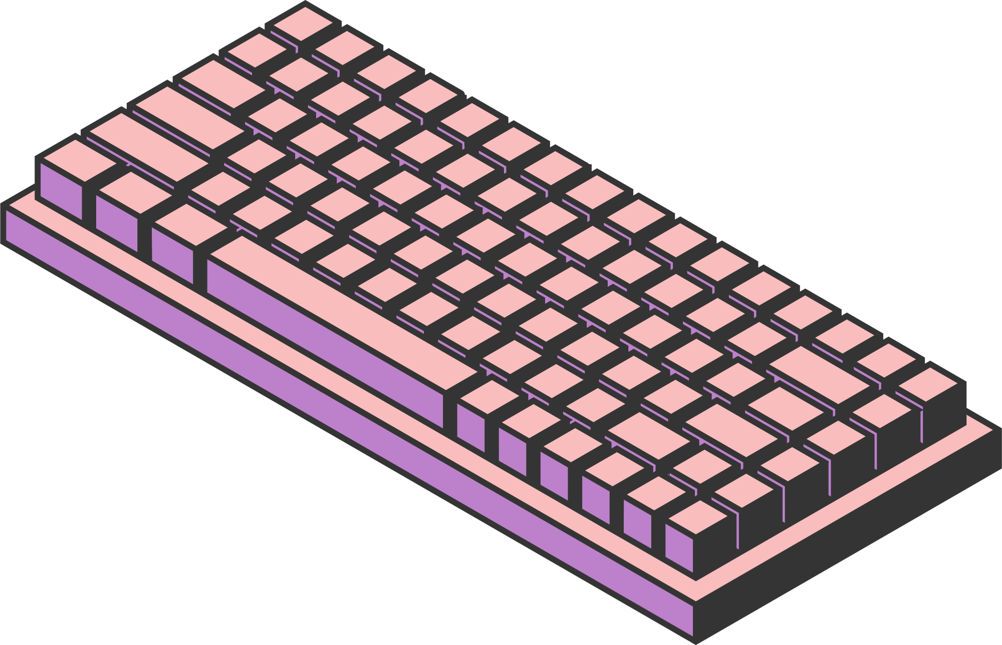
HOME
ABOUT US
MENU
CONTACT US
IT WST21
SEMIFINAL PROJECT
Page 01

Slide 2
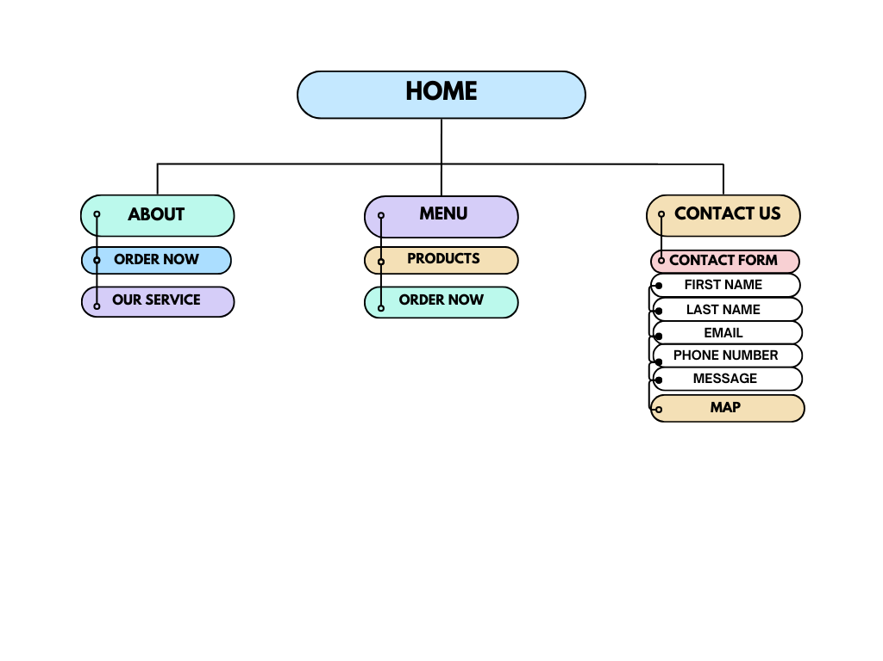
SITE
MAP
HOME
ABOUT US
MENU
CONTACT US

Slide 3
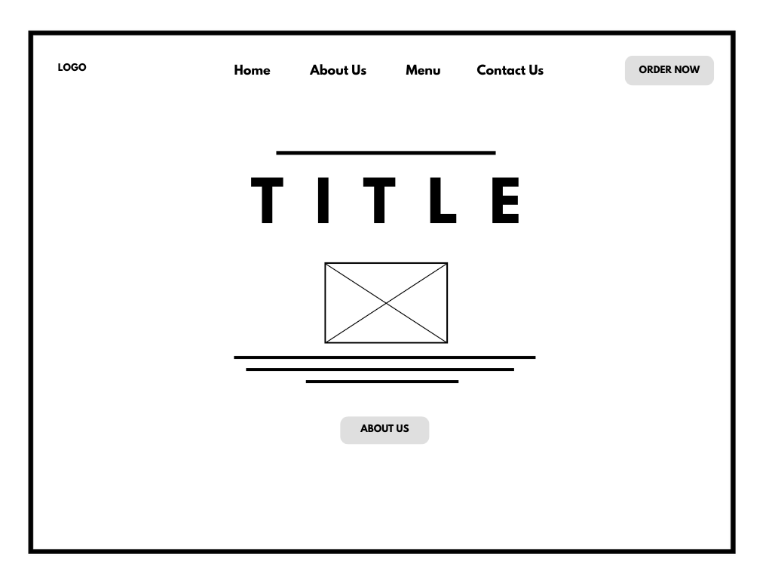
WIRE
FRAMES
HOME
ABOUT US
MENU
CONTACT US
Page 04

Slide 4
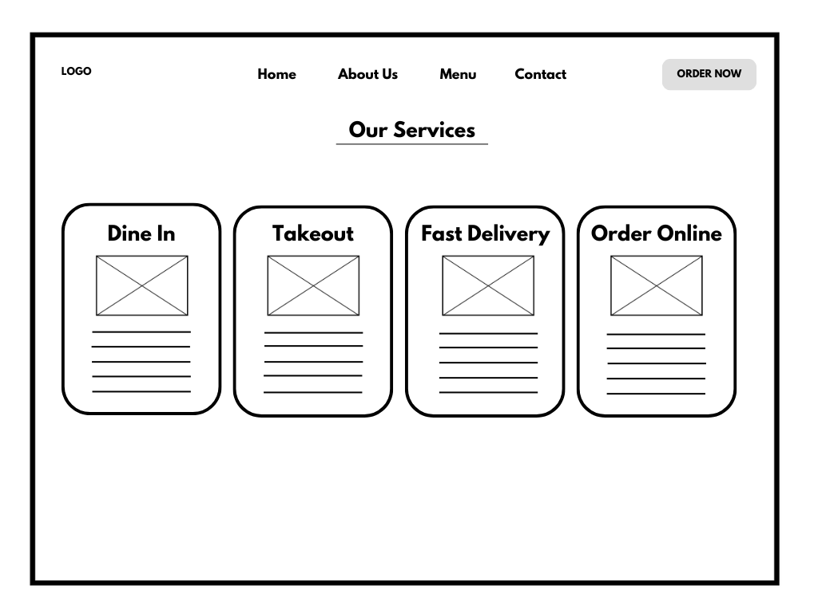
WIRE
FRAMES
HOME
ABOUT US
MENU
CONTACT US
Page 04

Slide 5
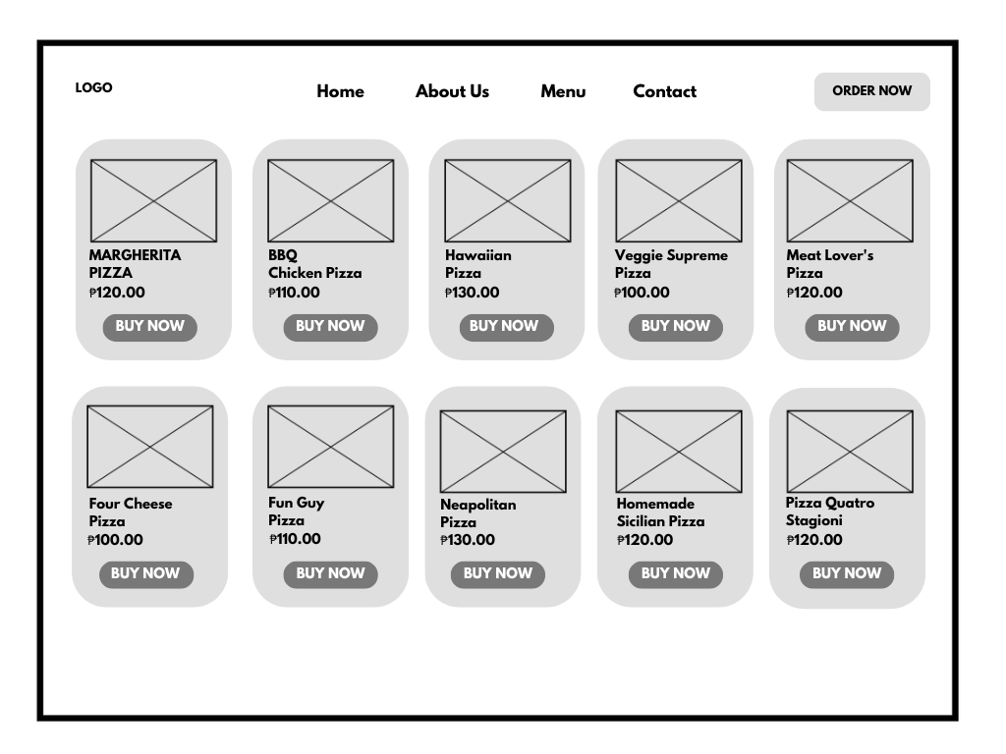
WIRE
FRAMES
HOME
ABOUT US
MENU
CONTACT US
Page 04

Slide 6
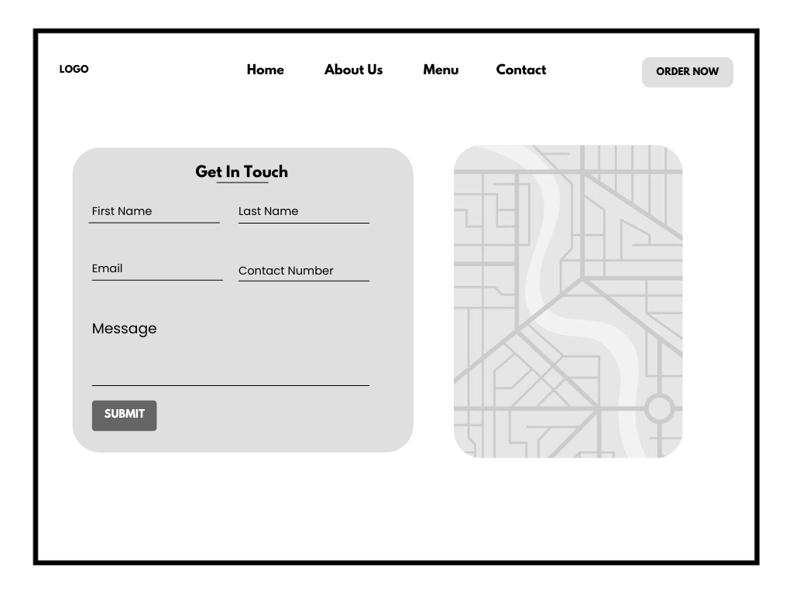
WIRE
FRAMES
HOME
ABOUT US
MENU
CONTACT US
Page 04

Slide 7




HOME
ABOUT US
MENU
CONTACT US
THANK YOU

